Slide 1

commerce sample dataset by vokraf
Gidion Buranda
https://colab.research.google.com/drive/15cNTJpfkrLggkDsUXhUTJmMwZLdzphD2?usp=sharing

Slide 2
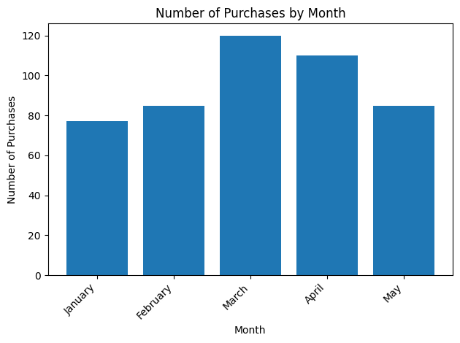
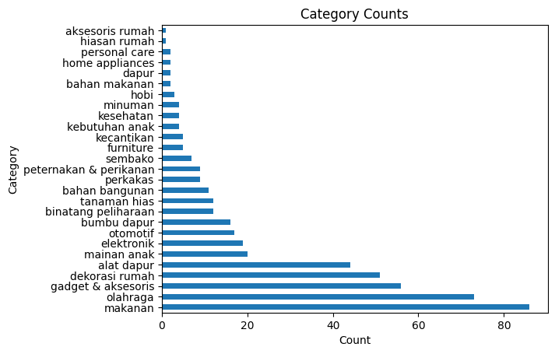
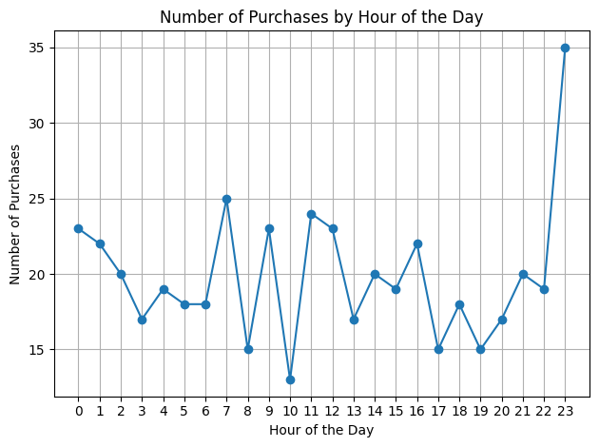
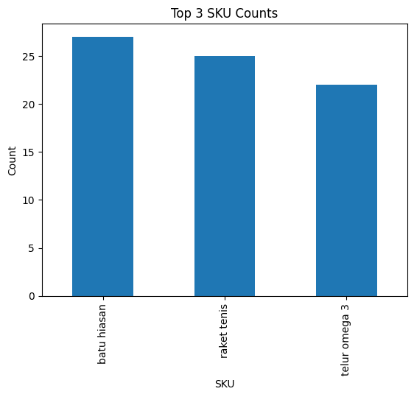
Mini dashboard of commerce sample dataset
Total Transaction
Rp 2T
Average Transaction Per User Value
Rp 5.7M
Top Categories:
Makanan
Olahraga
Gadget & Aksesoris

Slide 3
ABOUT THE DATA
Total Unique User : 372
Total Transaction : Rp 2T
Average Transaction Per User Value : Rp 5.7M
Median Transaction Per User Value : Rp 500.000

Slide 4
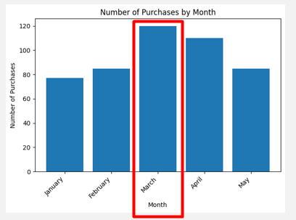
Insights
Most purchases come
from March.

Slide 5
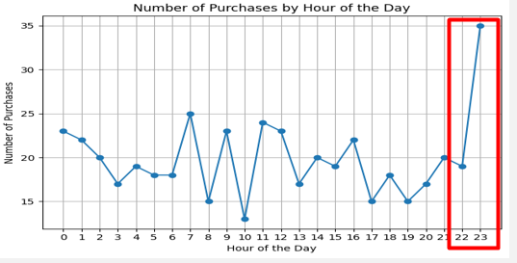
Insights
Most items are more likely to be purchased at night.

Slide 6
Insights
Batu Hiasan, Raket Tennis and Telur Omega 3 are the top 3 most purchased items.

Slide 7
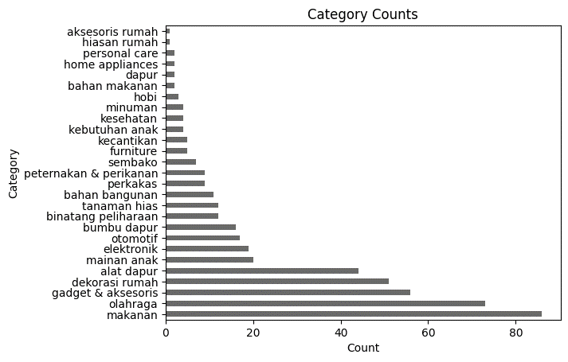
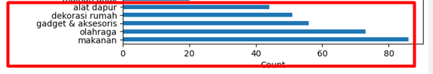
Insights
People are more inclined to purchase items from categories such as food, sports equipment, gadget accessories, home decorations, and kitchen tools.

Slide 8
What should the management do to increase the transaction?
Create a New Year's promotion, considering that the number of purchases is typically low at the beginning of the year.
Design a promotion that is exclusively valid from midday to afternoon.
Intensify our advertising and marketing efforts to expand our reach and encourage more people to utilize our e-commerce platform.

